Slide 1

Microsoft movie analysis
Leshmi Jayakumar

Slide 2

Summary
Microsoft wants to start a movie studio and is interested to know all factors needed to be successful.
This project is focused on several aspects of the film industry.
Which genre has the highest domestic gross?
Which movie studios with the highest domestic gross?
Which genre has the highest worldwide gross?
Which month is good for release?
Average Profit under which genre?

Slide 3

Outline
Business problems
Summary
Methods
Data
Results
Conclusion

Slide 4

Business problem
Create a new movie studio, but Microsoft don’t know anything about creating movies.
Microsoft want to know what types of films are currently doing the best at the box office.

Slide 5

Methods
Comparison of the different budgets on yearly bases and with a different genres.
Analyse average rating.
Analyse popular genres and studios which provide high profit
Analyse with the release date and the popular studios

Slide 6

Data
Movie datasets from:
Box Office .
IMDB
Rotten Tomatoes.
TheMovieDB
The Numbers
imdb.title.basics
imdb.title.ratings
bom.movie_gross

Slide 7

Results

Slide 8
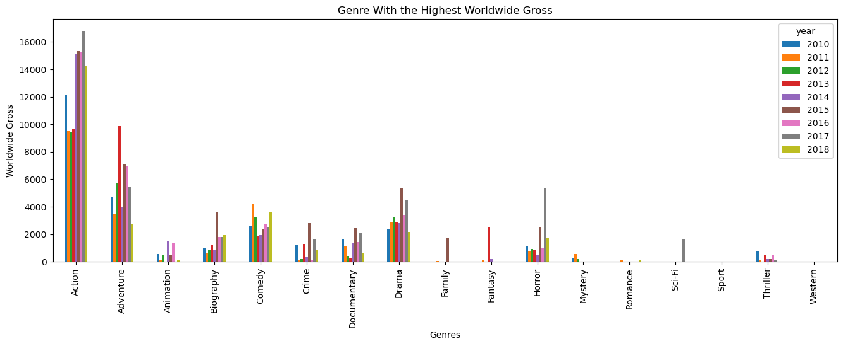
The four main genres with the highest worldwide revenue are action, adventure, comedy and drama.

Slide 9
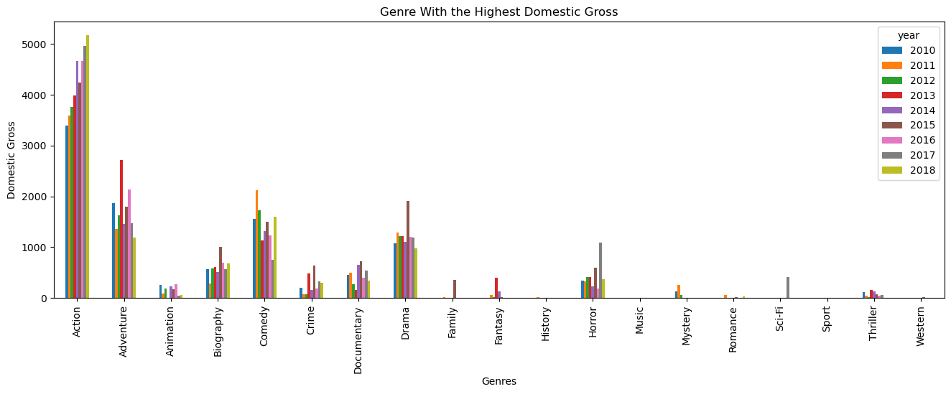
The four main genres with the highest domestic revenue are action, adventure, comedy and drama.

Slide 10
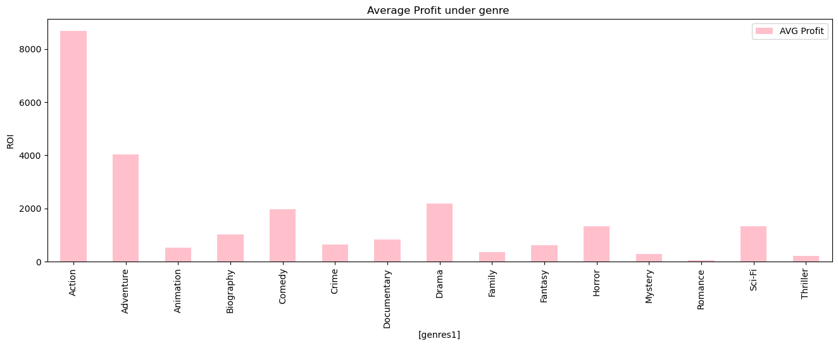
The average profit is maximum under action, adventure, drama and comedy.

Slide 11
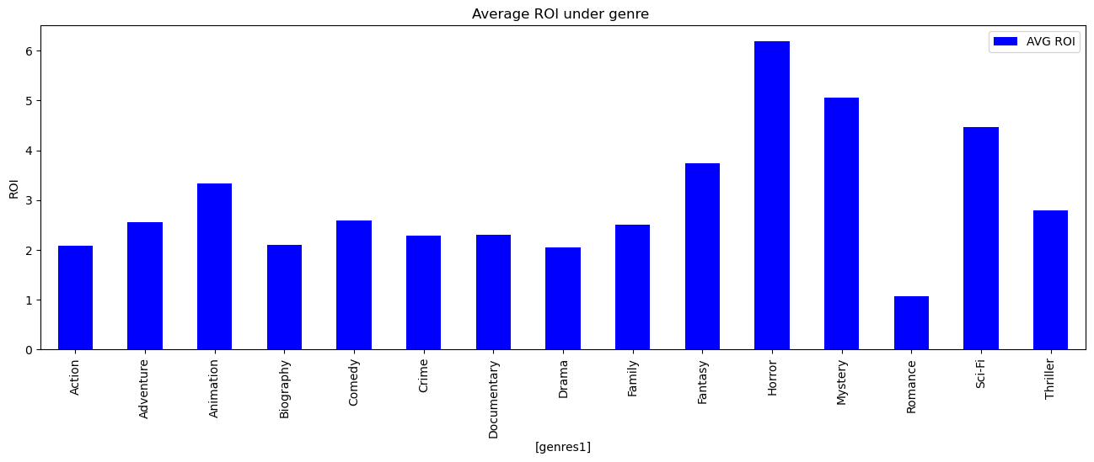
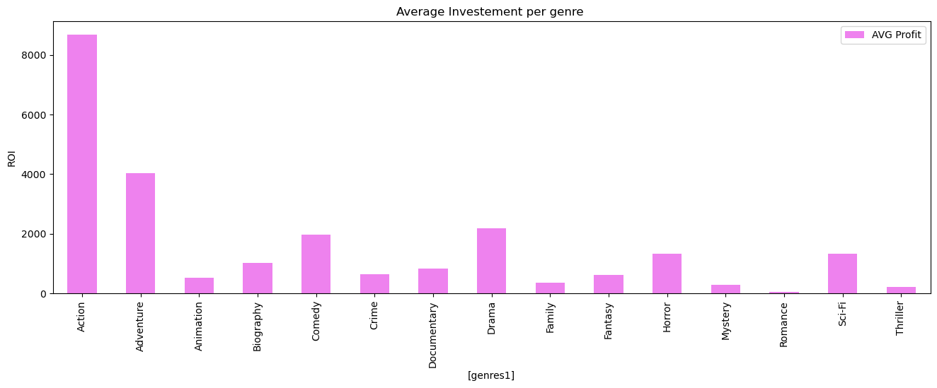
ROI, which is profit compared to the investment made, is for horror, mystery, sci-fi, fantasy, animation i.e., if you do not have a big budget, then it’s the above genres produce maximum profit

Slide 12
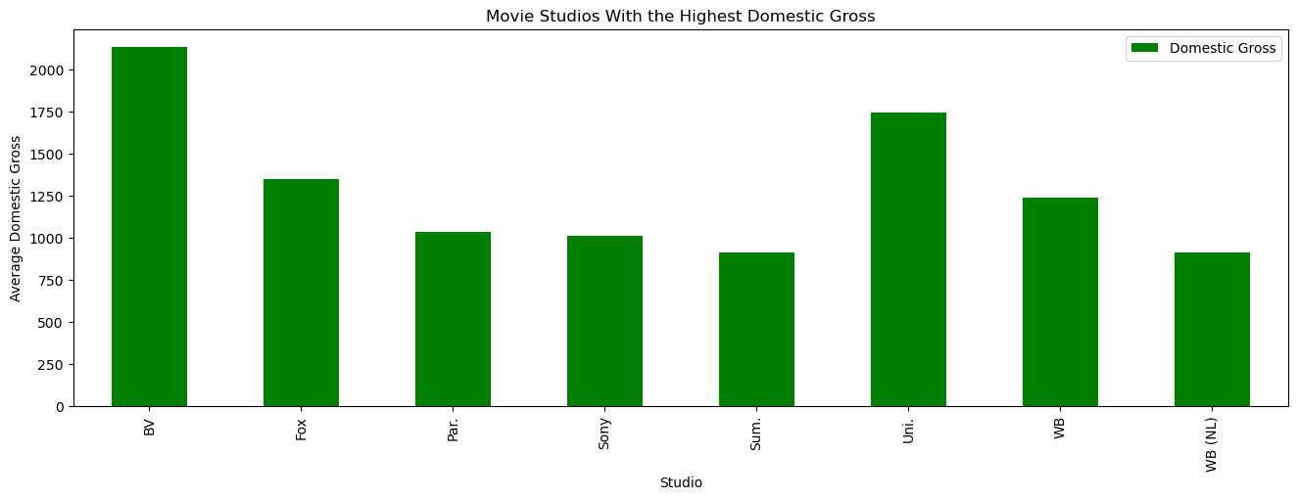
The studio which generates the highest domestic gross is BV, Uni, Fox and WB, if the movie maker is doing the movie with these studios, there is a high chance of profit.

Slide 13
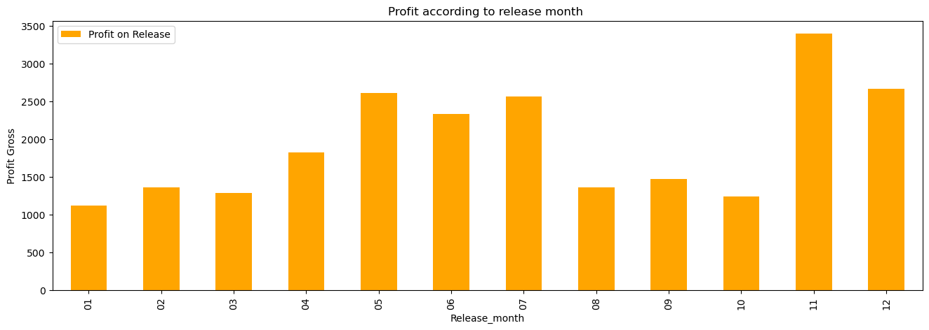
The release month which gives more profit are November, December, May, June and July, basically during the holiday seasons.
W

Slide 14

Conclusion
Microsoft is highly recommended to follow the following suggestion according to my analysis:
If there is a high budget available, the best movies to produce are in the genres of action, adventure, drama and comedy respectively as this gives the maximum revenue and subsequently profit.
If there is a budget constraint, the best movies to produce movies with high ROI: are horror, mystery, sci-fi, fantasy, and animation.
Best studios to collaborate with are BV, Uni, Fox and WB as they produce high-gross movies.
Best time to release movies is during Christmas and the School holiday seasons.

Slide 15

THANK YOU
Email: leshmi.Jayakumar@gmail.com
GitHub: Leshmi-Jkumar

